Slide 1
AVATAR LAB-
GENERATING REALISTIC AVATARS
~Praneetha(G-359)

Slide 2
PROJECT OVERVIEW & BUSINESS PROBLEM
What Will the Application Do? ✅ Convert text into expressive speech (Small-E) ✅ Generate realistic lip-synced facial animations (DiffTalk) ✅ Support real-time voice cloning for different speakers ✅ Enable AI-driven avatars for videos, assistants, education & gaming
Business Problem Addressed
🔹 AI avatars lack realistic speech & lip-syncing
🔹 Traditional models sound robotic and unnatural
🔹 Misalignment between speech and facial expressions reduces immersion

Slide 3
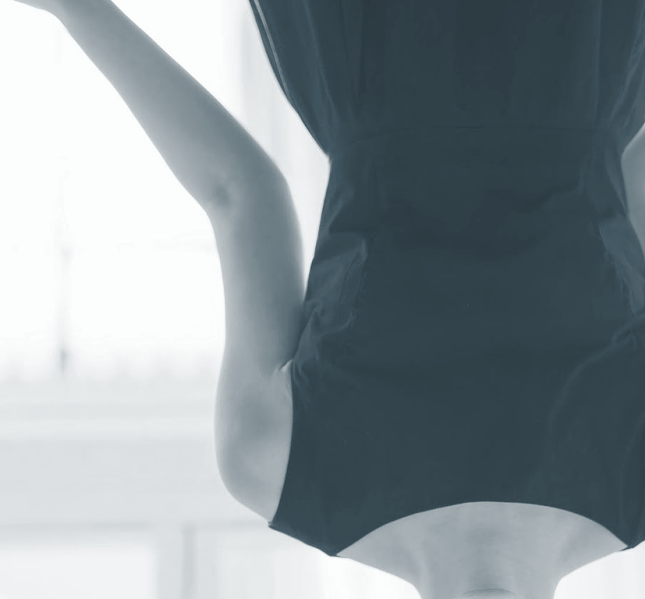
Tech Stack & Data Sources
📌 Data Preprocessing 🔹 Text Tokenization → Using Byte-Pair Encoding (BPE) 🔹 Speech Feature Extraction → Convert to Mel Spectrograms 🔹 Lip-Sync Alignment → Extract facial keypoints for motion mapping
📌 Tech Stack 🛠 Core AI & Speech Models: ✔ PyTorch – AI Model Training ✔ Diffusers – Diffusion models for facial animation ✔ MERN– Front-end and Back-end interface.
📌 Datasets Used 📂 For Speech Synthesis (Small-E):
LibriTTS, VCTK, Mozilla CommonVoice
📂 For Facial Animation (DiffTalk):
VoxCeleb2, LRS3, GRID Corpus

Slide 4
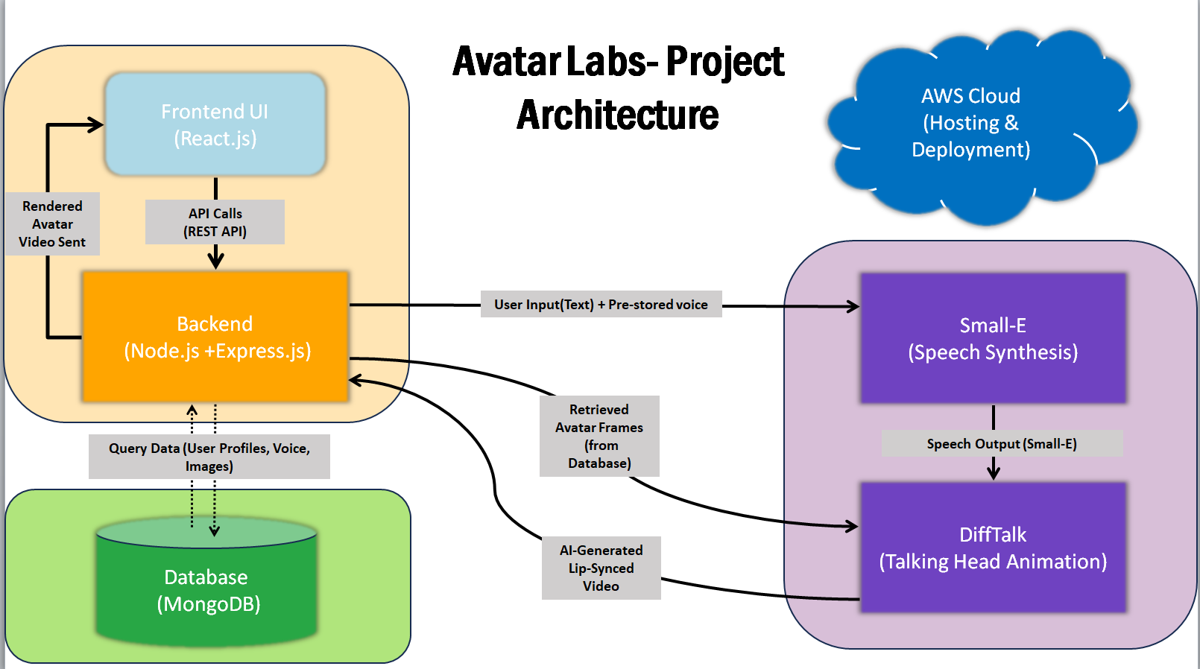
📌 Architecture Diagram (Workflow) 1️⃣ User Input → Text or Speech 2️⃣ Text Processing → Tokenization & Embedding 3️⃣ Speech Synthesis (Small-E) → Generates realistic voice 4️⃣ Facial Animation (DiffTalk) → Creates synchronized avatar motion 5️⃣ Output Generation → AI avatar speaks & moves realistically
Architecture Diagram

Slide 5
THANK YOU

